Slide 1
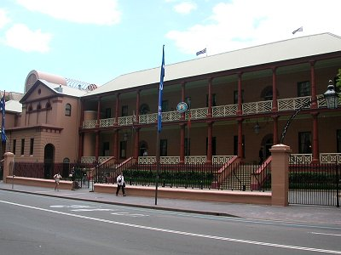
Engaging with ‘good’ public policy – concepts and practice

Slide 2
What does ‘good’ public policy look like?

Slide 3
Key definitions - Outcomes
Outcomes are the results, impacts and consequences of actions by a Government on the Community:
Planned outcomes are the results or impacts that Government wants to achieve for the community
Outcomes give public service a unique purpose
Actual outcomes are the results or impacts which are, in fact achieved.
External factors can intervene either positively or negatively on the achievement of outcomes
Agencies deliver outputs or a combination of outputs and administered items to contribute to planned outcomes.

Slide 4
Key definitions - Outputs
Outputs are the goods and services produced by agencies on behalf of Government for organisations or individuals.
Agencies deliver outputs to contribute to planned outcomes
Agencies also administer items - on behalf of Government - which contribute to outcomes
These ‘administered items’ may be used by third parties, rather than agencies, to produce outputs

Slide 5
Methodology
Outcomes
Outcomes
Effectiveness
Effectiveness
Sub-outcomes
Sub-outcomes
Outputs
Outputs
Efficiency
Efficiency
$
$
$
$
$
$
$
$
$
$
$
$
$
$
$
$
$
$
$
$
$
$
$
Inputs
$
Inputs

Slide 6
Exercise: Identify the inputs, outputs and outcomes
1. Budget allocation to a government agency
2. Research paper on road deaths
3. Number of police in the service
4. TV advertisements about tourism
5. Road death trends

Slide 7
Exercise: Identify the inputs, outputs and outcomes
6. Introduction of IT systems
7. Number of students attending secondary schools
8. Policy advice
9. Number of patients treated in public hospitals
10.Tourist visit numbers

Slide 8
Why we should commit to ‘good’ public policy!

Slide 9
Networks and policy
Networks
Involve a range of people who represent a variety of organisations
Have moderately stable patterns of ties or links between these people or their organisations. These ties/links represent some form of recognised accountability between those in the network
Are ideally built on trust, respect and diplomacy
Effective network management is essential for effective policy

Slide 10
Collaborative Practice – what is your situation?
Collaborative advantage – is a situation where something can be achieved which could not be achieved by any of the agencies working alone
Collaborative inertia – is a situation where what is achieved is negligible or such a hard grind and so slow that people stop participating (Huxham 2003:403)

Slide 11
Political Nous

Slide 12
Political Nous – what is it?
“Political Nous is the ability to develop knowledge about contextual factors (sometimes subtle and seemingly unconnected) that impact on decision-making and build awareness of the political context, the needs and interests of government, ministers and other stakeholders. It also includes an ability to use judgement to apply this knowledge and awareness and act constructively”
(based on original research conducted by People and Strategy)

