Slide 1
Engaging with Public Finances
Commonwealth Parliamentary Association Australia and Pacific Regional Conference 2017
Jubilee Room
Parliament House
Margaret Crawford
Auditor-General of New South Wales
25 October 2017

Slide 2
Engaging with public finances and the work of the Auditor-General
The Auditor-General is a valuable resource
What we do and how we frame our program
Expectation management – the constraints and opportunities

Slide 3
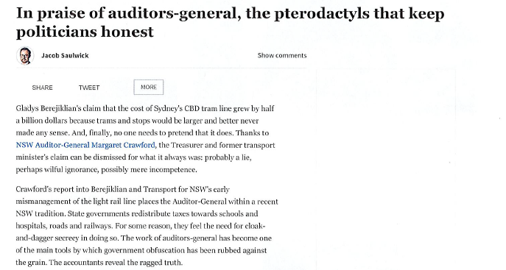
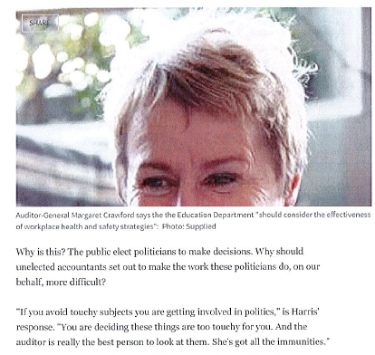
Role of the Auditor-General
Proud history
Important watch-dog agency
Independent
Support Parliament hold Government accountable for its use of public resources
Office of around 270 professionals

Slide 4
Art or science?
Core business
Statutory financial audits – state entities, universities, councils
Performance audits – twenty per year
Reports to Parliament
Coverage
Risk
Scale and impact
Public interest
Relevance to our key client – Parliament of NSW

Slide 5
The world we operate in
Growing lack of trust in traditional institutions
Increasing expectations of government service delivery
Digital disruption and cyber security
Governments working more through non-government agencies
A greater focus on outcomes measurement

Slide 6
Expectation Management
Backward looking with an eye to the future
Can only comment on audit findings
Limited resources
Business model constraints
Independence - cannot be part of government decision making

Slide 7
“High quality financial management and reporting are crucial to properly inform the public and build community confidence in our system of government”
Report on State Finances – October 2017

