Slide 1
Rail Infrastructure Project Costing from strategic planning to commissioning
Bob Miller
Jacana Consulting
Copyright 2011

Slide 2
CONTENTS
1. Introduction - Key Questions
2. Rail Infrastructure & Cities
3. Policy & Planning
4. Major Rail Infrastructure Costs
5. Rail Vehicles & Project Costs
6. Ticketing Systems
7. Inter State Rail
8. Rail Freight Infrastructure
9. Methodologies
10. Recommendations

Slide 3
Rail Infrastructure Project Costing 1. Introduction - Key Questions
Rail Infrastructure Project Costing Inquiry
Why is rail infrastructure needed?
Who develops rail infrastructure?
How is rail infrastructure developed?
What are the key components in development?
What components contribute to high costs?
What processes assist to contain costs?
Where have rail project costs been contained?
Why have projects often been started & stopped?

Slide 4
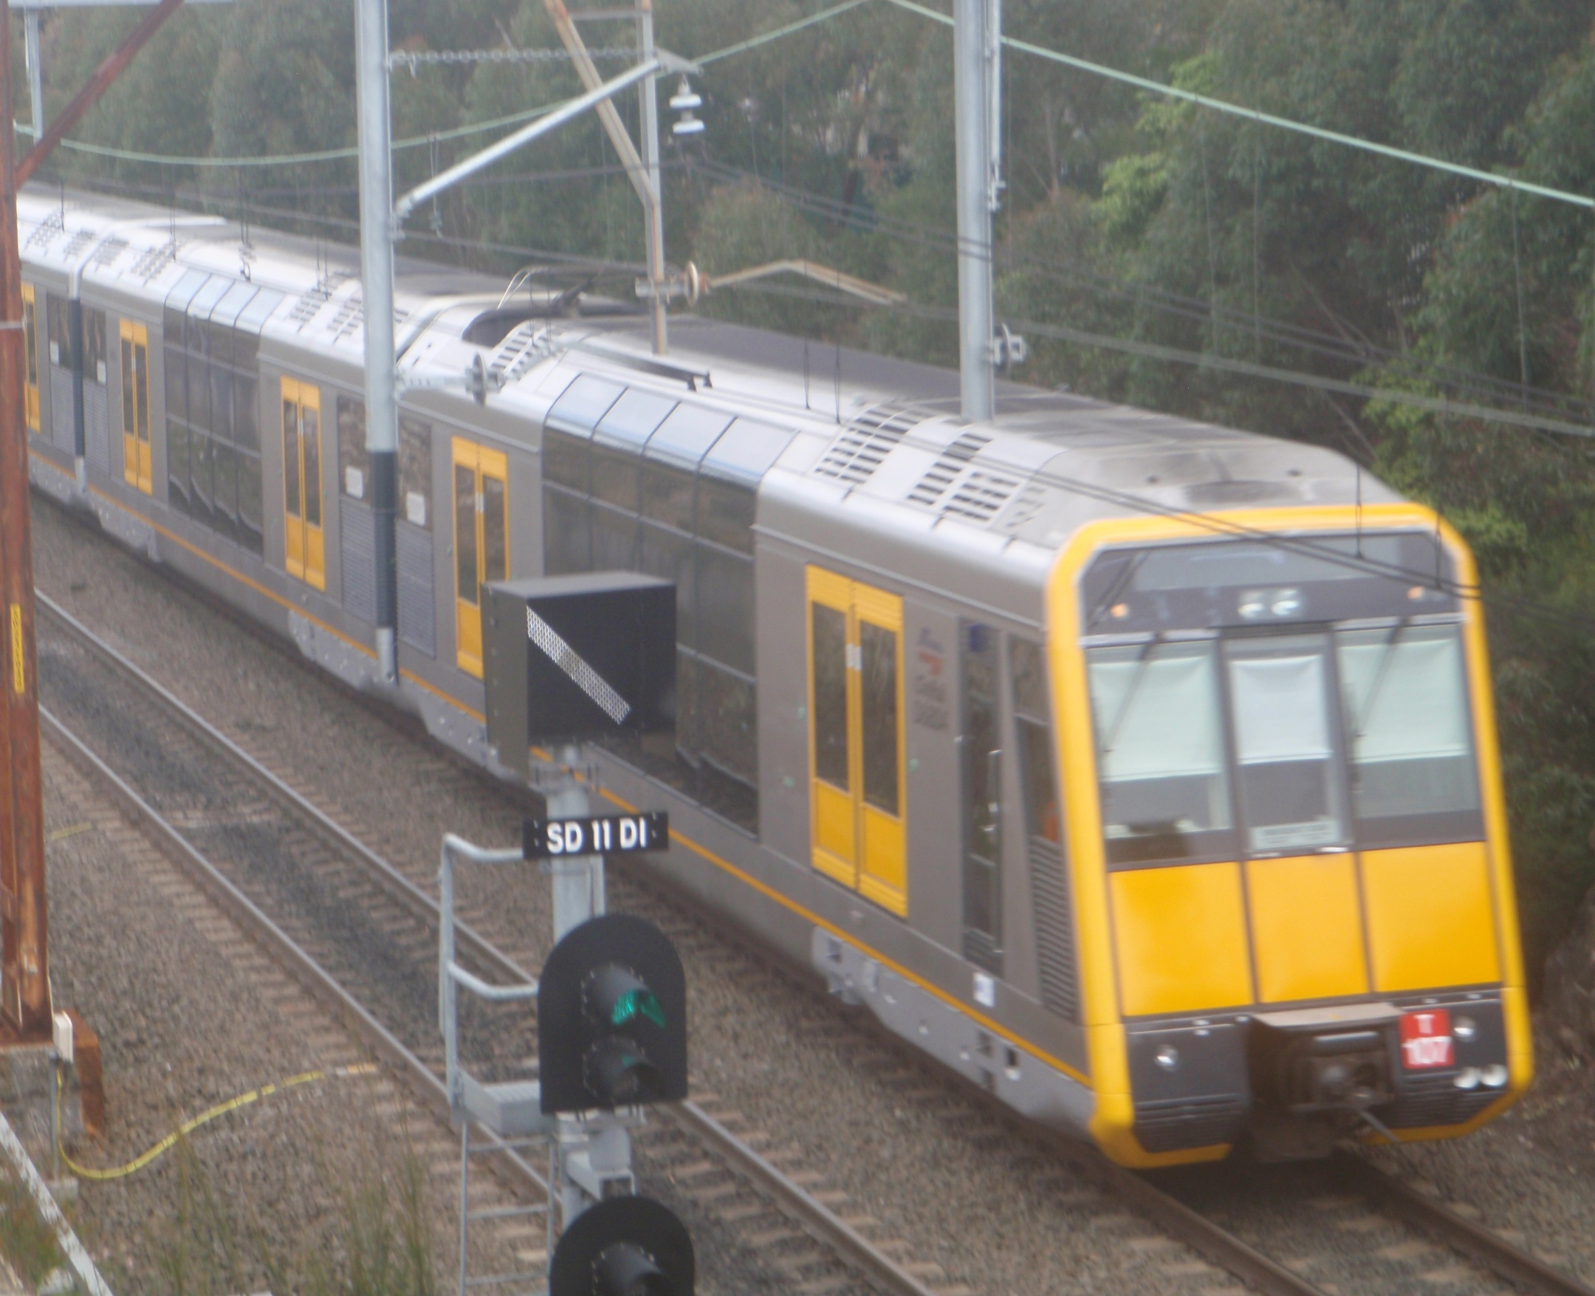
Insert Phot - Tangara

Slide 5
Rail Infrastructure Project Costing 2. Rail Infrastructure & Cities
Most choose to have it - if affordable
But, some big cities don’t have it
Why do we need it ?
Support business activity in large CBDs
Efficient, reliable & safe for high volume commuting
Competitive with road travel time
Low energy & pollution emissions
Avoids high parking fees & capital costs
Containing high Infrastructure costs requires long term planning commitment

Slide 6
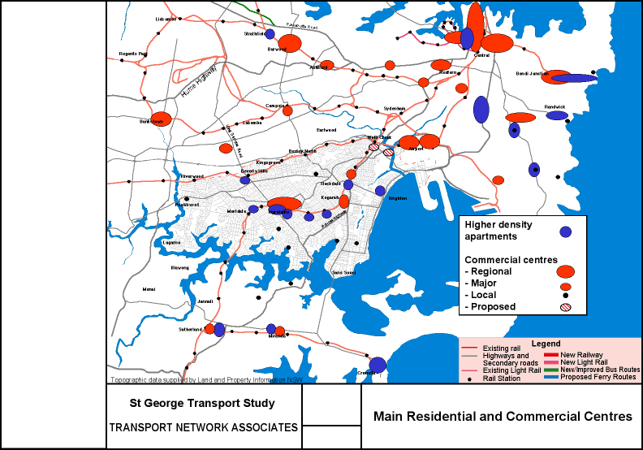
Integrating Land Use & Transport
Land Use Nodes & Networks
Passenger Networks - Road & Rail
Freight Networks - Road & Rail

Slide 7
Rail Infrastructure Project Costing 3. Policy & Planning
Metropolitan land use planning:
Housing - 70% In fill, 30% green field
Retail, commerce affects rail passenger potential
Industry location affects rail freight potential
Influences location of multi modal interchanges
Influences the demand for rail infrastructure
Influences the cost of rail infrastructure
Can assist to contain costs

Slide 8
Rail Infrastructure Project Costing 3. Policy & Planning cont.
Land use & node development influences:
Corridors, alignments, demand & project length
Level of service - speed, frequency etc
Rail vehicle type - train, metro, LRT, freight, etc
Network type: radial, tangential, triangle, box
Level of multi modal integration
Interchange effectiveness
Customer access & demand

Slide 9
Rail Infrastructure Project Costing CBD Rail
Long routes, slow & costly
CBD station capacity constraints
CBD corridors - long lead time / very costly
Metro stopped - but medium term potential
Light rail opened in 1990s
Started Lilyfield to Dulwich Hill extension 2011
“Low cost” option to extend LRT to CBD & Sydenham

Slide 10
Rail Infrastructure Project Costing Light Rail/Metro cont.
Route options
Brookvale - Airport
Parramatta - CBD-Maroubra
Inner City planning
Stopped in 2004 & 2009
Key steps include:
Network plan & development priorities
Corridor identification, adoption & gazettal

Slide 11
Rail Infrastructure Project Costing Greater Sydney
Many potential rail projects
Competition for funding
Newcastle rail service?
CBD Metro/LRT
N.W rail line
S.W. rail line
High Speed Rail?
Epping-Parramatta funding?
Maldon - Dombarton
Federal funding to complete design for ‘shovel ready’

Slide 12
Rail Infrastructure Project Costing Regional Planning & Transport
Focus on land release - housing & business
RTA regional motorway plans rolled out
Little regional rail infrastructure improved in 25 yrs
CountryLink XPT 25 years old
Few improvements to train & coach services
Casino - Murwillumbah rail line closed
Newcastle - largest regional city - branch line under threat
Private Coach & XPT trains compete
Insufficient integration e.g Coffs Harbour & Grafton

Slide 13
Rail Infrastructure Project Costing Land use planning
Conclusions
Metropolitan planning improvements
Rail corridor & infrastructure planning over recent years
Land use - transport integration significant progress
Regional planning improvement needed
Land use & transport integration yet to be realised
Rail services cut to many cities & towns over 40years
Oil dependence - key risk for Transport & Agriculture
World oil price risks - post GFC
Land use transport integration framework
A high priority across NSW

Slide 14
Rail Infrastructure Project Costing Regional Rail
CountryLink services
XPT - Sydney to/from:
Grafton - Coffs - Taree
Goulburn - Wagga - Albury
Regional rail services:
Moree & Armidale
Dubbo & Broken Hill
Griffith & Canberra
Country Regional Network
Train & infrastructure renewal options?

Slide 15
Rail Infrastructure Project Costing 4. Major Rail Infrastructure Costs
Corridor infrastructure (electric train)
Stations, access, ticketing & information systems
Interchange &/or commuter parking
Track, drainage, fencing, bridges, tunnels, etc
HV electric supply & traction power
Signalling (track side or ATP)
Communications (driver/guard/ train controller)
Train control centres & signal staff
Train maintenance & crew facilities
Train terminals & storage sidings
Commissioning

Slide 16
Rail Infrastructure Project Costing Project Delivery
Transparency & accountability issues
Problems for private & public sectors
E.g. defence procurement, motorways & rail
Planning costs & project delivery
Costs estimates & contingencies
Demand estimates & feasibility process
Treasury gateway process & approval
Railcorp & TCA sign off functional spec
Railcorp sign off on commissioning
Co-ordination & staffing need to be resolved

Slide 17
Rail Infrastructure Project Costing Project Delivery cont.
Key steps
Land acquisition - negotiation, survey, sale contract, title transfer
Commissioning plan needs early sign off
Contract preparation & amendment costly
Design - survey, utilities, geotech, hydrology, structural, architecture,
Construction
Site & track possessions
OHS, workforce availability, training
Testing & Commissioning

Slide 18
Rail Infrastructure Project Costing Project Delivery cont.
Cost escalation - Major factors
Excessive project estimates
Total project to direct costs increased
Contractor compliance costs increased
Risk averse conditions & lack of staff empowerment
Regulator conditions insufficiently prescriptive
Extensive negotiation before conditions accepted
Site conditions - most onerous adopted as norm
Affects both road & rail project costs

Slide 19
Rail Infrastructure Project Costings 5. Rail Vehicles
Project Costs
Passenger train infrastructure
Design standards usually based on heavy locomotives
Single deck trains
Double deck trains
Light rail infrastructure
Substantially less than heavy rail
Dedicated off road corridor preferable
On road priority essential for on time running

Slide 20
Rail Infrastructure Project Costing 6. Ticketing Systems
Zone ticketing a key issue
London & Hong Kong have it
Zone based travel flexibility, rather than route fares
Ridership increase offsets revenue decline
Melbourne has it - Zone, time based & multi modal
Swiss have it
Multi modal zone ticket with on board fare premium
Counter peak discount fare to fill empty seats
Sydney does not have it - one of few cities in world not to use Zone based system

Slide 21
Rail Infrastructure Project Costing 7. Inter State Rail
Federal issues
High Speed Rail - Phase 1 report
Melbourne-Sydney-Brisbane corridor defined
Road Freight
Inter state trucks benefits from motorways
Rail freight infrastructure
Recent upgrade, but lower standard
Inter state mode share collapse over 30 years
Low market share - containers, steel trains & wheat
Transport safety

Slide 22
Rail Infrastructure Project Costing Interstate Rail Infrastructure
Current & future?
CountryLink services
XPT Brisbane - Sydney - Albury - Melbourne
Sydney - Canberra
XPT & infrastructure renewal options?
High speed rail?
Phase 1 report 2011
Phase 2 report 2012

Slide 23
Rail Infrastructure Project Costing High Speed Rail Infrastructure
Train type | Curves Typical Radius (m) | Speed* Typical km/hr
NSW (east coast) | 400-800 | <110
XPT (c.1960s) | 1,200 | <160
Europe (typical) | 2-3,000 | 250
HSR Europe, China Aust (Proposed**) | >7,000 | 300
NOTE * Commercial operating speed -** Max test speeds over 500km/hr

Slide 24
Rail Infrastructure Project Costing High Speed Rail @ Max 350 km/hr
Route | Distance (≈kms) | Hours (est*)
Brisbane - Syd | 1,080 | 3.9
Newcastle - Syd | 170 | 1.0
Syd - W’gong | 80 | 0.6
Syd - Canberra | 300 | 1.5
Syd-ACT-Albury - Melbourne | 850 | 3.2
NOTE * Subject to no. of stops & speed in cities

Slide 25
Rail Infrastructure Project Costing High Speed Rail cont.
Major City Comparisons
Route | Population | Population per Route Km (est.)
BRISBANE-SYDNEY | 8,136,076 | 6,895
SYDNEY - ACT - MELBOURNE | 8,788,878 | 9,251
NEWCASTLE-SYDNEY | 2,311,272 | 17,917
NEWCASTLE - PARRAMATTA -W’GONG | 2,818,475 | 11,274

Slide 26
Rail Infrastructure Project Costing 8. Rail Freight Infrastructure
Interstate freight
40 years of Federal interstate highway investment
Replaced poor infrastructure with new alignment
major reduction in operating cost for trucks
Rail freight
Upgraded with little improvement to alignment & grade
Longer passing loops, modest reduction in operating costs
ARTC Rail freight infrastructure
Poor track maintenance in parts of NSW & Vic
Significant safety issues

Slide 27
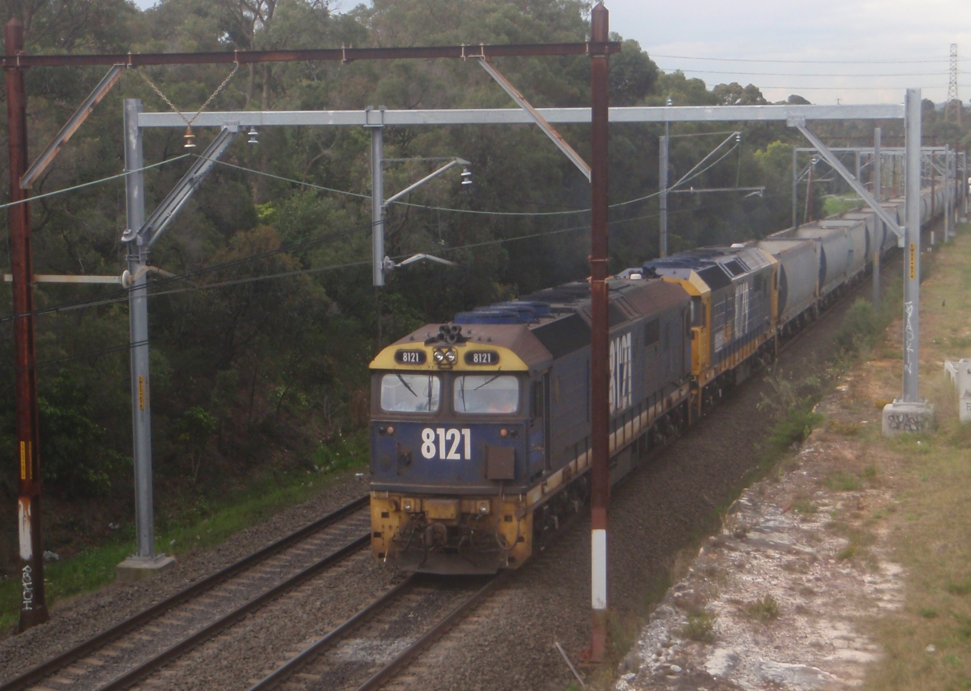
1980s Diesel locomotives still in use Electric locomotives phased out in 1990s

Slide 28
Rail Infrastructure Project Costing Rail Freight cont.
Networks
Metropolitan Network
Country Regional Network
Historic legacy - poor alignment & grades
Track closures
Ports
Port Botany trucks vs rail options
Newcastle - coal & wheat
Port Kembla coal, wheat & cars
Maldon - Dombarton rail line
Nearly half built since 1980s
Refer to case study

Slide 29
Rail Infrastructure Project Costing Sydney Rail Freight Constraints
ARTC Sydney freight line contracts
Construction stopped & recommenced:
Main South
Sefton - Cabramatta
Main North freight line being designed
Projects being considered include:
Lidcome Junction - coal trains
Tempe Junction - coal trains
Maldon - Dombarton (by pass Sydney south)

Slide 30
Rail Infrastructure Project Costing Interstate Freight
Intermodal - Million Net Tonne Kilometres
 |  |  | NSW - VIC |  |  |  |  | NSW - QLD
 |  | Total | Road % | Rail % | Coastal% |  | Total | Road % | Rail % | Coastal%
1975-6 |  | 1,859 | 76 | 23 | 1 |  | 1,467 | 60 | 35 | 4
2005-6 |  | 8,978 | 95 | 5 | 0 |  | 8,586 | 93 | 5 | 2
1975-2005 |  | 382% | +25% | - 78% | -100% |  | 485% | +55% | -86% | -50%

Slide 31
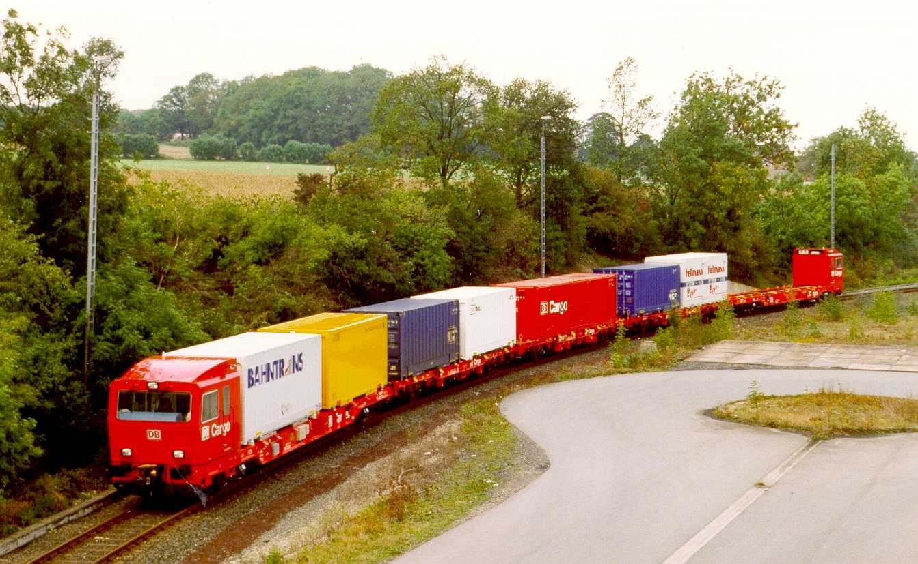

Slide 32
Rail Infrastructure Project Costing Regional rail freight shuttle
Recent development in freight trains
More flexible & efficient than heavy rail
Lighter & faster than heavy rail locomotives
Large reduction in operating costs
Direct from port to inland freight terminals
Container service options
Urban - Port Botany to terminals/ warehouses
Regional - Port Botany to regional terminals
Interstate - Port Botany to terminals /warehouses

Slide 33
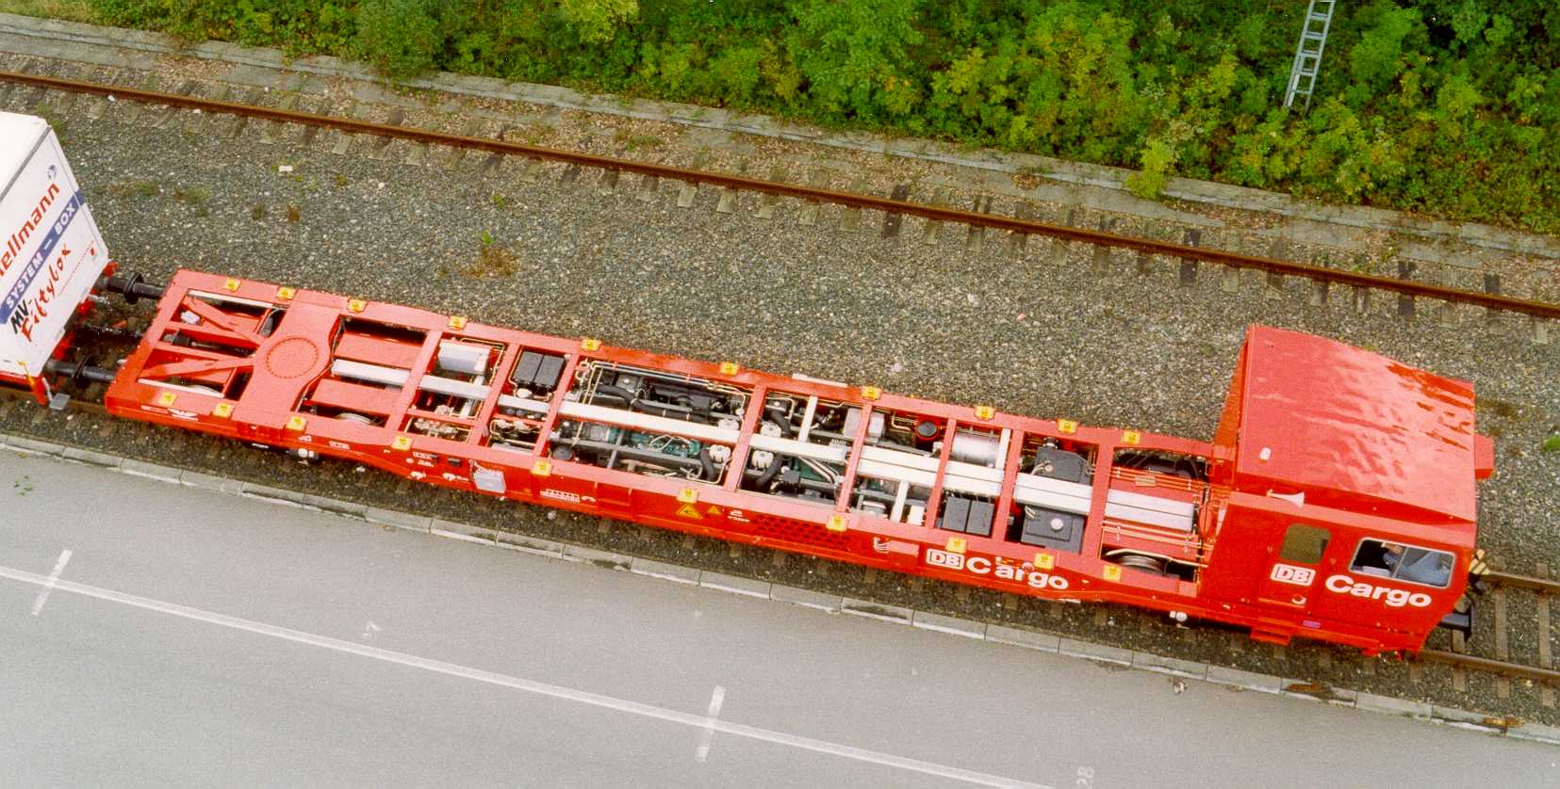
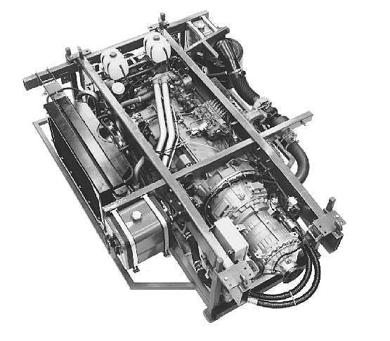
+ = 530 kW

Slide 34
Rail Infrastructure Project Costing 9. Methodologies
Treasury gateway process
BCA inputs & outputs
Costs - Validate capital & recurrent estimates
Benefits - financial, social, environmental
Risk analysis
Economic BCA
Financial BCA
Discounted cash flow rates
Funding approval & finance
Inclusion in State capital works budget

Slide 35
Rail Infrastructure Project Costing Methodologies cont.
Methodologies need improving
Project feasibility, demand & BCA deficiencies
Review Network benefits & risk management
World best practice for network development
Rail program management priorities
Investigate project options & comparisons
Preliminary estimates - for project comparisons only
Detailed cost estimates - before project approval
Detailed investigation - before design/construct contracts
Minimise project scope changes - esp after project approved

Slide 36
Rail Infrastructure Project Costing 10. Recommendations
Metropolitan plan & regional planning
Develop MOU to involve Council representation on working groups to include:
Integrated Land Use Transport planning to further develop transport nodes
Multi-modal network planning
Best practice network planning needed
Joint rail-road corridor development - include other services and providers
Land use transport integration framework
Strengthen to assist State & local planning
Needs high priority across NSW

Slide 37
Rail Infrastructure Project Costing Recommendations cont.
Greater Sydney rail freight costs
Develop plan to achieve targets for rail freight market share in/out of Port Botany, Enfield & Moorebank
Investigate rail network & terminal infrastructure options for Newcastle, Western Sydney & Wollongong
Assess feasibility of rail shuttle services

Slide 38
Rail Infrastructure Project Costing Recommendations cont.
Efficient rail infrastructure project costs:
Land use - transport integration framework based on hierarchy of currrent node development & future potential
Network planning - based on efficient Swiss techniques
Service schedules - based on multi-modal integration & guaranteed connection locations
Hierarchy of interchange locations: CBD to suburbs

Slide 39
Rail Infrastructure Project Costing Recommendations cont.
Obtaining value & containing costs
Establish rail infrastructure planning & investigation fund as occurs overseas
Ensure roll out of rail infrastructure plan options, cost comparisons & feasibility
Compare rail projects achieve best value
Project priorities should include investigation of long term AC electrification options

Slide 40
Rail Infrastructure Project Costing Recommendations cont.
RailCorp workforce
Enhance workforce planning capacity
Fill engineering & other technical staff shortages
Strengthen technical workforce capacity
Address aging workforce challenge
Consider trainee/scholarship program

Slide 41
Rail Infrastructure Project Costing Recommendations cont.
State agency public interest test
Include sustainability & infrastructure objectives in corporate missions
Provide CEO statement on contribution to State sustainability & infrastructure outcomes in annual reports
Develop performance indicators to improve agency transparency
Include in executive performance contracts

