Slide 1
Evaluation of the Multicultural Peer Network
Insight Consulting Australia

Slide 2
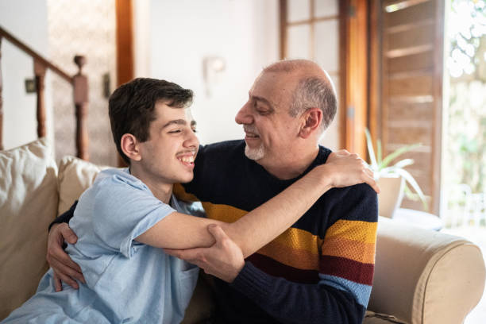
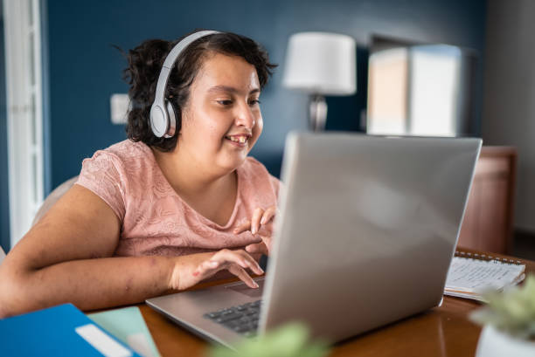
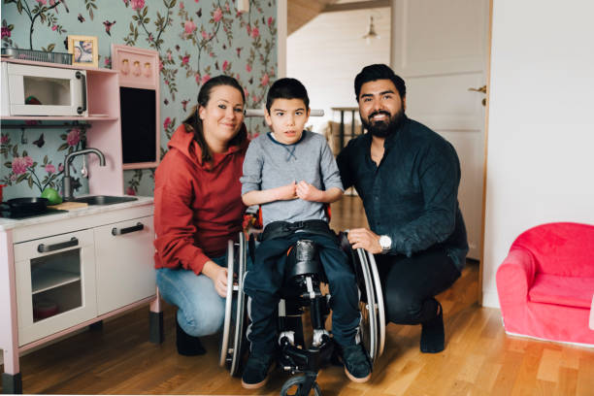
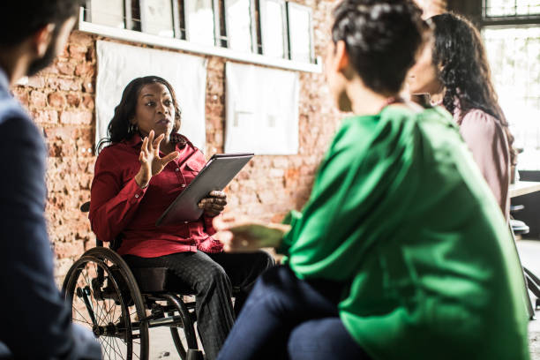
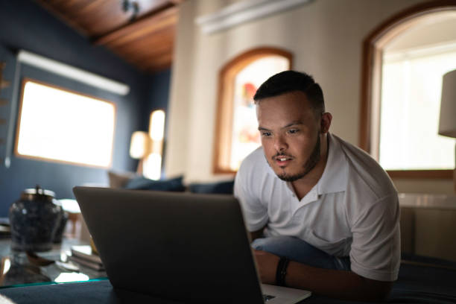
Multicultural Peer Network
Overview:
The Multicultural Peer Network (MPN) is an initiative of Settlement Services International, funded by the Department of Social Services through the Information Linkages and Capacity Building Stream. The program aims to increase independence and access to the NDIS, and operates across Greater Sydney and Regional NSW.
Emerging community leaders are recruited and trained to facilitate culturally based peer networks and discussions on
volunteering
employment
self-advocacy
accessing the NDIS and
building circles of support.
Network sessions are predominately culturally based in order to respond to the language and cultural needs of participants. Facilitators act as ambassadors in their community, reaching out to a wide range of community members, helping to reduce stigma associated with disability and caring.

Slide 3
Multicultural Peer Network
Rationale:
People with a disability from culturally and linguistically diverse backgrounds, and their carers, may experience a range of challenges including:
lack of knowledge about a complex service system and access points
lack of comparable service systems in their home country
lack of translated information about services
difficulties communicating with service providers
different cultural understandings of concepts such as disability, caring and advocacy
social stigma or shame associated with disabilities in their own culture and/or the wider Australian community
social isolation
difficulties accessing employment and volunteering opportunities
and the physical and emotional demands of living with a disability and/or caring.

Slide 4
Language spoken at home | Number who speak English well or very well | Number who do not speak English well or at all
Mandarin | 13452 | 6002
Arabic | 22044 | 3885
Cantonese | 11031 | 3630
Vietnamese | 6117 | 3249
Greek | 12323 | 1358
Korean | 2845 | 1160
Assyrian Neo-Aramaic | 2133 | 745
Italian | 10035 | 687
Macedonian | 3685 | 539
Spanish | 6026 | 537
Chaldean Neo-Aramaic | 852 | 530
Turkish | 2422 | 473
Khmer | 789 | 365
Serbian | 2624 | 362
Persian (excluding Dari) | 1927 | 325
Punjabi | 3164 | 322
Thai | 1211 | 300
Russian | 2009 | 255
Bengali | 3082 | 251
Croatian | 3059 | 241
Nepali | 2494 | 224
Urdu | 2941 | 218
Portuguese | 1682 | 214
Min Nan | 727 | 203
Indonesian | 1716 | 196
Dari | 745 | 195
Hindi | 5789 | 191
Kurdish | 302 | 181
Tamil | 2796 | 158
Priority cultural groups:
This table shows the number of people in NSW who have a need for assistance with their core activities who speak a language other than English at home.
Data from the 2021 Census of Population and Housing, Australian Bureau of Statistics

Slide 5
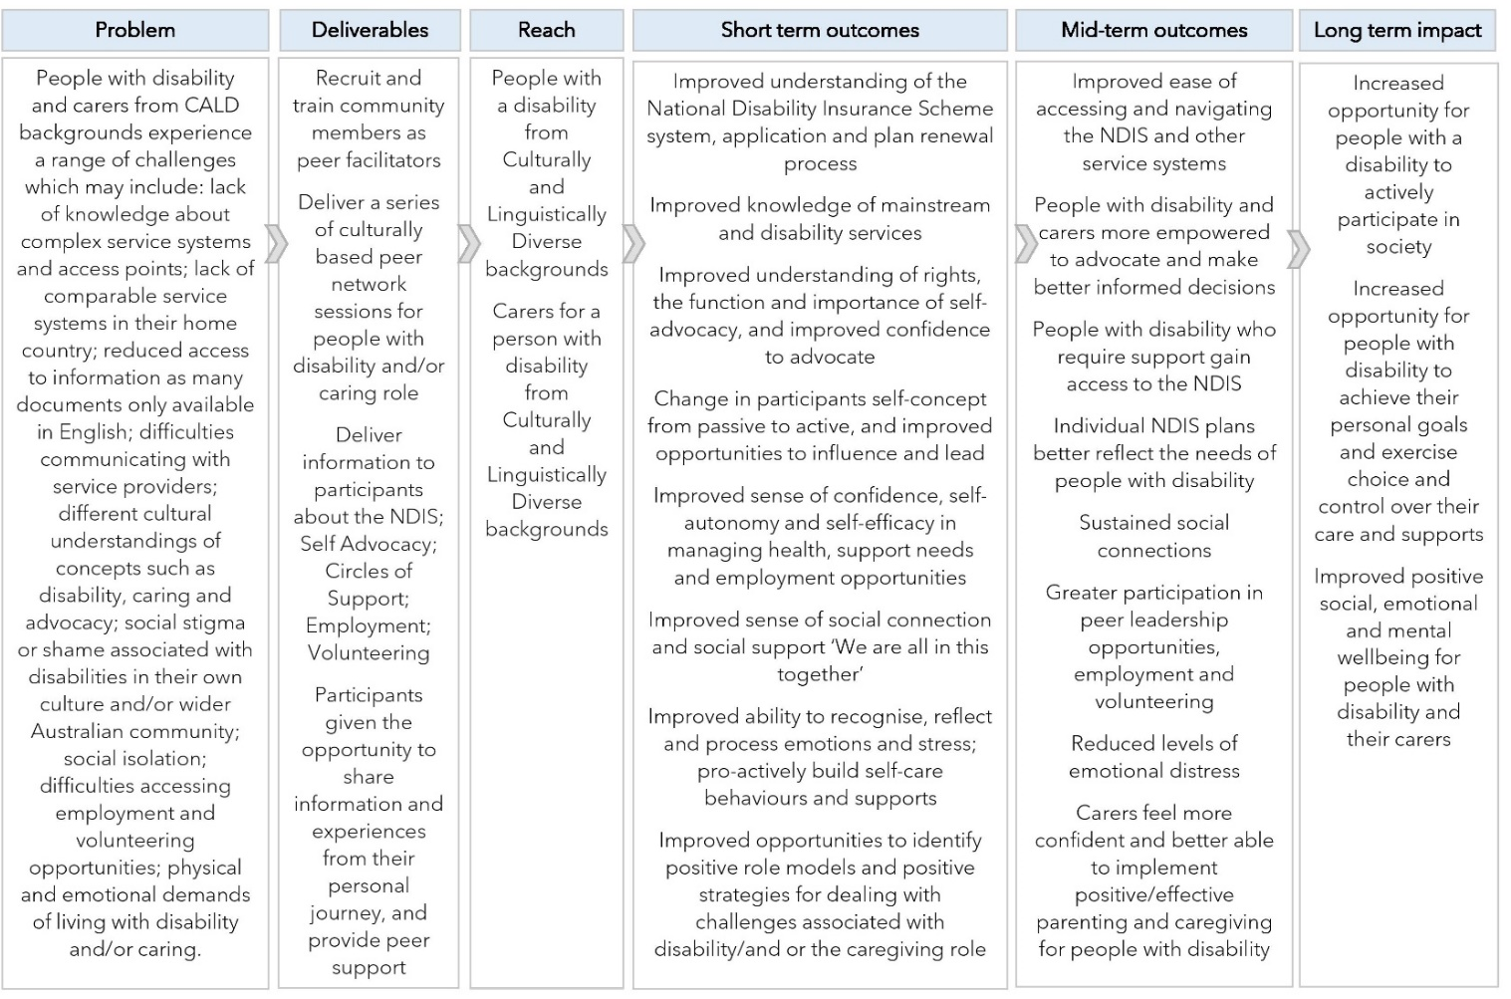
Theory of change:
Research evidence demonstrates that peer support program can be effective for young people, people with a disability, and carers.
When members of a peer support network share personal characteristics (such as age, language or cultural background) or lived experiences (such as having a disability and/or caring for a person with a disability) the efficacy of intervention is enhanced, isolation among group members reduced, and group trust, empathy and connection boosted.
The Results Logic Diagram below shows the program deliverables and anticipated short, mid and longer term outcomes.

Slide 6
Evaluation approach:
For the purposes of this evaluation, a range of methodologies were used to examine if the program carried out its intended functions in the intended manner, and if short and mid term outcomes from the Results Logic Diagram were achieved.
Evaluation activities included:
review of project documentation
analysis of more than 100 facilitator session feedback forms
analysis of feedback survey forms completed by 65 network participants (17 PWD and 48 family members/carers)
group interviews with network members, including people with disability, family members/carers, and facilitators
1-on-1 interviews with network members, facilitators and stakeholders
consultation with the project Reference Group.

Slide 7
Challenges:
The advent of COVID-19, and associated lockdowns, caused significant disruption to the wider community services sector during 2020 and 2021, with many providers ceasing or significantly limiting support to society’s most vulnerable during the crisis. The previously unquestioned reliance on face-to-face models of service delivery was brought into the spotlight, with services needing to rapidly reimagine and reconfigure new models of care.
While face to face meetings paused for Multicultural Peer Networks during lockdown, most switched to online meetings. This change was challenging for a number of community members who did not have experience with online technology, and had restricted physical access to family members who could assist in setting up technologies.
Some participants originally resistant to remote technology were later able to join online networks and gain skills and confidence in remote technology. Their increased capacity will improve their access to online services and support in the future. While some members did not sustain their participation into the remote environment, for many others it provided benefits such as saved travel time and opportunities to balance participation with caring and other responsibilities.
The new mode of service delivery also provided opportunities for community members to participate who, due to their disability, would not normally be able or willing to meet face to face.

Slide 8
Process Evaluation findings
Deliverable 1: Recruit and train community members as peer facilitators
The program successfully recruited, trained and supported 71 emerging leaders to become peer facilitators for the program, with presentations taking place in 14 different community languages: Mandarin, Cantonese, Arabic, Persian, Vietnamese, Hindi, Dari, Nepalese, Thai, Bengali, Karen, Chin Haka, Zomi and English.
Facilitators reported satisfaction with the training and support they received, and a range of personal benefits including the opportunity to give back to their local community. It is expected that these improvements will not only bring benefits and improved capacity to participants but also result in benefits to the wider community of people with disabilities.
Approximately one third of facilitators employed in the program have a disability and examples were relayed to the evaluator about participants successfully stepping into facilitation roles. The use of peer facilitators is considered appropriate for ensuring accessibility, reach, and cultural appropriateness of topic content and delivery.

Slide 9
Process Evaluation findings
Deliverable 2: Deliver a series of culturally based peer networks sessions
The program successfully delivered a large number of education sessions relevant to the needs of people with a disability from culturally and linguistically diverse backgrounds.
Although there were changes in delivery mode from face to face to remote technology, which resulted in changes in network membership and reach, overall members appear to have adapted to the online environment and find participation beneficial and relevant.
The number of network sessions for each network was greater than originally planned, to enable the provision of additional support and information to participants.

Slide 10
Process Evaluation findings
Deliverable 3: Deliver information for participants
Information sessions focused on the five key topics of Volunteering; Employment; Self-advocacy; Accessing the NDIS; and Building circles of support. Participants reported satisfaction and benefits from discussing each of these topics, which are directly relevant to the program aim of increasing independence and access to the NDIS and other support services.
Potential program improvements identified were: to provide groups with a choice of topics and scheduling; to add an introductory session before the core topic content is introduced; and to reserve some time in meetings for general discussion. While out of scope for this project, carers requested further support on employment options and skills for their loved ones with a disability.

Slide 11
Process Evaluation findings
Deliverable 4: Participants share information and experiences, and deliver peer support
A vital part of the MPN program is the opportunity for participants to share personal feelings and experiences, providing practical and emotional support to one another. In addition to the stress and fear of living in a pandemic, people with a disability and their carers faced a number of challenges during lockdown including difficulties in providing home learning for children; social isolation; and a reduction of available support services, such as personal care. In this environment, it became even more important to provide an opportunity for participants to connect with others.
The peer support element of the program is valued by participants and provides important practical and emotional benefits to participants.
A positive but unintended consequence of the adapted and extended mode of delivery is that the MPN has been a timely support to people who were socially isolated due to the pandemic.

Slide 12
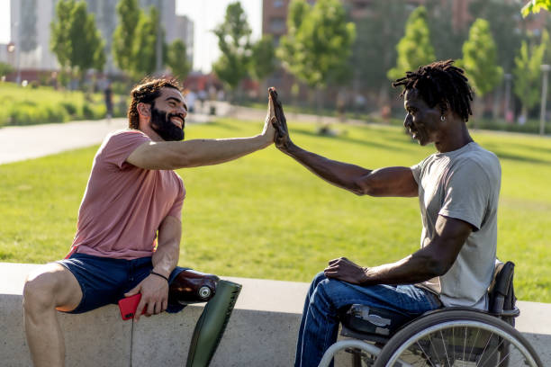
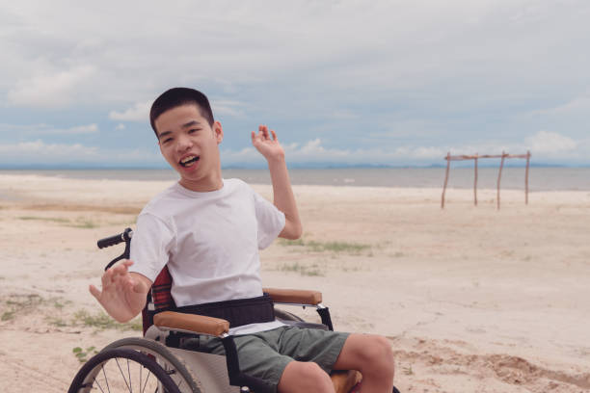
Quantitative project outcomes:
Feb 2020-June 2021: 28 peer networks established for 314 participants
July 2021-June 2022: 39 peer networks established for 452 participants
July 2022-Feb 2023: 30 peer networks established for 313 participants
Overall result: 97 Multicultural Peer Networks established, for 1,079 participants
This result was significantly above the project goal of 65 peer networks established.

Slide 13
Outcome 1: Improved understanding of the NDIS system, application, and plan renewal process
The Outcome Evaluation found that the MPN was instrumental in reaching a large number of people with disabilities and/or their carers from culturally and linguistically diverse communities.
In total, 97 Multicultural Peer Networks were established with over 1,000 people participating in sessions. Each network presented and discussed information about the NDIS system, application, and plan renewal process.
Guest speakers delivered information about how to access and use NDIS in a flexible manner during the COVID19 associated lockdowns, to ensure participants received information and assistance they needed.
Many network participants indicated that their knowledge and confidence in accessing the NDIS had improved as a result of the program.
Quotes from participants, facilitators and stakeholders:
“Participants were happy to learn about NDIS and share the information with their families and friends”
“One participant never heard before about NDIS”
“We provided all relevant contacts and information to help and support their request of NDIS”
“The parents were very motivated to share their concerns, experiences and questions navigating the NDIS pathway”
“We reached a very large cohort of the Vietnamese community. We held 3 sessions for 60 people, delivering NDIS information in language, with a direct contact with someone from NDIS”

Slide 14
Outcome 2: Improved knowledge of mainstream and disability services
Network members were provided with a range of information about mainstream and disability services relevant to their needs.
The peer support element of the program enabled group members to share their knowledge and experiences of navigating these systems, while participants were able to encourage each other to utilise services to meet their needs/the needs of the person they cared for.
Service information was presented in spoken language during network sessions, with written information provided in languages relevant to the group. In total, written information was provided across the program in 14 community languages.
Quotes from participants, facilitators and stakeholders:
“All shared their experiences with the early intervention services and getting their assessments and evaluations”
“There was general concern regarding mental health and wellbeing for parents and carers. Information about Mental Health Care Plan under Medicare was provided, and regarding other services that could help and support them”
“The participants were very happy with the information, which is relevant for them and their children”
“More information about support for disability”
“Motivation to get help when needed”
“Know how to ask for help when needed”

Slide 15
Outcome 3: Improved understanding of rights, function and importance of self-advocacy,
improved confidence to advocate
Group members reported increased confidence, interest and ability to advocate in the interest of their rights. A majority of participants (84% PWD & 92% family members/carers) agreed that they were more knowledgeable about their rights, and that they had new skills to help them achieve their goals (85% PWD & 97% family members/carers).
Participants were able to learn from the formal information presented, as well as through hearing the personal perspectives and experiences of other group members.
Quotes from participants, facilitators and stakeholders:
“Participants were interested in how to advocate to their local government regarding their rights and services they need”
“One of the mothers with a child with Down Syndrome shared her experience with NDIS and how she used self-advocacy to get services and therapies for her daughter”
“Participants shared their experiences and discussed how they could work together as a self-advocate group to resolve or minimise issues”
“Learn self-advocacy and teach their children to use self-advocacy in their lives”

Slide 16
Outcome 4: Change in participants’ self concept from passive to active, and improved opportunities
to influence and lead
Quotes from participants, facilitators and stakeholders:
“Peer supporters translate if we can’t bring someone in – the slides are in language so it makes it easy. That builds capacity in them as leaders, so they can support their community. Builds a skillset and belonging. It’s community supporting community”
“It builds skills to open employment options – ongoing benefit”
“Learn to not be afraid to come online”
A majority of participants (78% PWD & 71% family members/carers) reported increased leadership and influencing opportunities as a result of their participation in the program.
This outcome was particularly evident for the 71 emerging community leaders who were recruited, supported and trained to be group facilitators. It is expected that many of these leaders will continue to grow in their leadership potential and will be a valuable asset to their local communities/cultural groups.
Feedback from facilitators shows that they have experienced growth in their facilitation skills, for example by making content more interactive and discussion based in order to increase engagement with participants.
A number of group facilitators reported that their participation in the program had opened up new opportunities for them in employment and leadership positions.

Slide 17
Outcome 5: Improved sense of confidence, self-autonomy, and self-efficacy in managing health,
support needs and employment opportunities
The program is having a positive impact on participants, helping them to feel empowered over health and support decisions.
For some members, the network provided an important first opportunity to talk about their health and support needs, in a group environment of trust and connection.
A majority of group members (92% PWD & 87% family members/carers) reported increased confidence and motivation as a result of participating in the network.
Quotes from participants, facilitators and stakeholders:
“A couple of mothers were interested in volunteering opportunities for their teenage children as a pathway for employment during school holidays or when they finish their high school”
“Some mothers discussed volunteering opportunities for themselves, especially in the disability sector, to obtain skills and experiences to use with their own children”
“Without MPN, they would never have had that opportunity to be paid, get skillset and grow”
“One of the participants wanted to be a facilitator and has now become a co-facilitator. He has anxiety and speech disorder. He wants to run a group in his special needs school and for his parents as well”

Slide 18
Outcome 6: Improved sense of social connection and social support
Many group members (85% PWD & 88% family members/carers) reported an increase in their connections in community.
The peer support element of the program was found to be beneficial for young people, people with a disability, and carers and allowed members to share common experiences and interests.
It is expected that many of the social connections formed during the program will continue beyond the project funding, providing a sustainable avenue for social support. Many participants are very committed to meet at least once a month to keep engagement and support each other.
Quotes from participants, facilitators and stakeholders:
“The meeting is a very good chance for our children for learning and talking. I think it is very good”
“Created a space where people could be heard during a time that everyone felt isolated”
“Talk with others about the same topics”
“The mothers are happy to keep this group as a support group or circle of support for them and their children, also to advocate for each other and third-party organisations”
“All the participants are motivated to keep the contact after the sessions finished”

Slide 19
Outcome 7: Improved ability to recognise, reflect, process emotions and stress; pro-actively build
self-care behaviours and supports
The peer network model enabled participants to identify and share common life experiences, concerns and challenges and draw strength from the stories and perspectives of others.
Participants shared their experience in realising that they were not alone, and reported gaining strength through these social interactions.
Many participants (92% PWD & 84% family members/carers)
believed they were more valued by people around them, as a result of their experiences in the program.
Quotes from participants, facilitators and stakeholders:
“I don’t feeling lonely“
“The participants were enthusiastic with ideas to organise themselves as a Circle of Support to work toward their goals as group”
“New friends share experience in life”
“I am less stress”
“We brainstorm about all the opportunities and circumstances that we could use a circle of support: supporting NDIS applications, looking for resources and professionals’ therapists, and others”
“I use circles of support “
“More peer connections”

Slide 20
Outcome 8: Improved opportunities to identify positive role models and positive strategies for
dealing with challenges associated with disability and/or the caring role
Family members and carers reported particular benefits from the opportunity to discuss the challenges of their caring role, and strategies for effective parenting of neurodiverse children.
Networks provided a chance for participants to identify positive role models, and motivate and encourage one another.
The evaluation found increased rates of self-efficacy among participants with a majority of participants (85% PWD & 87% family members/carers) agreeing that they could have a say on issues important to them.
Quotes from participants, facilitators and stakeholders:
“It help a lot to build up ourself and to listen to other mothers and members and get more information. It’s very helpful”
“Joining this group is kind of like a daily motivation for me to live. Sometimes I face difficulty in life that’s really challenging and sometimes I feel very disappointed, but when I join this group and hear the other group member – the other people also have their own challenges even worse. I feel more confidence, have more motivation to continue the carer work and stay positive about my life condition”
“I can make a change as well”

