Slide 1
Mindframe
October 2018

Slide 2
Acknowledgements
Acknowledgement of Country
‘We acknowledge the Traditional Owners of country throughout Australia
and recognise their continuing connection to land, waters and culture.
We pay our respects to their Elders past, present and emerging.’
Acknowledgement of lived experience

Slide 3
Pride in Diversity
Established in 2010
NFP member organisation
280+ members
National reach
Public and private sector
Transition support services
Consulting & training
HR policy and practice review
Benchmarking (AWEI)
Pride in Practice annual conference

Slide 4
Roadmap
Challenging time for LGBTI people
Minority stress
Respectful LGBTI language
This is a candid discussion in a safe environment to address personal questions, concerns and/or experiences.
Notes:
Terminology – transitioning and gender affirmation mean the same thing.

Slide 5
Making submissions
This inquiry is likely to be very challenging for LGBTI people:
Those making submissions and being witnesses
Those hearing about this in the media
While this inquiry is very important for the LGBTI community, it will also be revisiting very difficult times and experiences
This is why your sensitivity and your use of appropriate & respectful language will be so important.
Notes:
Terminology – transitioning and gender affirmation mean the same thing.

Slide 6
Minority Stress
LGBTI people have higher rates of mental health and suicide:
Twice as likely to experience anxiety disorders
Three times more likely to experience affective disorders such as depression
Five time more likely to experience major depressive episodes
Significantly more likely to attempt suicide (especially in the Trans community)
This disparity is not a result of gender or sexual identity, but the result of stigma, discrimination and violence

Slide 7
Respectful language
Using respectful language can reduce the anxiety that many in the LGBTI community will feel when making submissions to the Inquiry
Using the acronym and knowing what the letters mean:
LGBTI
Q
Gender and sexual identities
They are different
Use of pronouns and salutations

Slide 8
Chris Nelson
Relationship Manager
Pride in Diversity
Phone: (02) 9206 2137
Mobile: 0429 007 180
Email: cnelson@acon.org.au
Web: www.prideindiversity.com.au

Slide 9
Everymind
Everymind is a leading national Institute dedicated to reducing mental ill-health, reducing suicide and improving wellbeing for all Australians.
We have been delivering world-leading, evidence-based prevention programs for over 25 years.
www.everymind.org.au

Slide 10
Purpose
To equip Parliamentary Members and Committee members to safely and effectively communicate about suicide and mental illness
When questioning individuals about their experiences of hate crimes
When/if working with the media

Slide 11
Duty of care
Taking care of yourself and others during and after this workshop.

Slide 12
Mindframe
Collaborates with the Australian media and other sectors to encourage responsible, accurate and sensitive portrayal of mental illness and suicide.
Aims to:
Provide leadership with in the sector
Build the capabilities of the sector and other stakeholders
Innovate and disseminate education, resources and information
Increase research to support evidence base
Invest in our organisation and people to deliver good outcomes

Slide 13
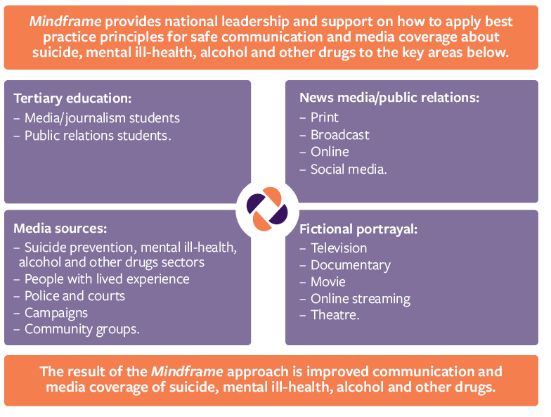

Slide 14
Why do we need to consider the way that we communicate about suicide?

Slide 15
What we do and don’t know
What we know:
talking to someone about suicide will not increase suicide risk
media reporting of suicide deaths has been associated with increased risk for those who are vulnerable.
What we’re still uncertain about:
whether conversations or more media reporting about the issue will increase or decrease suicide risk.

Slide 16
Mindframe principles & tips for managing communication

Slide 17
Impact of discussing suicide
Risk generally increases when discussion:
Details method and location
Sensationalises suicide
Is prominent and repeated (such as media reports)
Focuses on an individual who has died (especially celebrities)
Glamourises or glorifies the death

Slide 18
Mindframe principles – discussions of Suicide with those with Lived Experience
To decrease risk it may be helpful to:
Provide context with questions around incidents
Frame suicide as a tragic, avoidable loss
Focus on the factual, negative impact on others
Promote help-seeking information in all conversations discussing suicide
Follow up with speakers post interviews
Notes:
The media has a role to play in raising awareness of suicide as a public health issue and prevention behaviour
Reporting that focusses on suicide as a health and community issue (never as a crime) helps to challenge public misconceptions and myths, increase community awareness and decrease stigma and encourage discussion and prevention activities
This includes reporting about the broader issue of suicide for example analysis of policy, practice, research, rates and trends
To decrease risk it may be helpful to:
Provide context
providing general information about suicide and its relationship to mental illness and other risk factors;
Avoiding simplistic explanations that suggest suicide might be the result of a single factor or event.
Highlighting the difficulty of the issue; it may have many layers and a number of risk factors and warning signs.
Frame suicide as a tragic, avoidable loss – most suicide can be prevented
Focus on the negative impact on others –
to increase community understanding can increase understanding about the experiences of those affected by suicide.
and challenge thoughts of suicidal person re: burdonsomeness
Explore stories of overcoming suicidal ideation
can promote hope and may encourage others to seek help
- Promote help-seeking information
It’s helpful for reporting to inform the community about
causes of suicide,
warning signs,
the importance of taking suicidal thoughts seriously and
providing information about where people can get support
e.g. helpline contacts and information about crisis support services, treatment and support options
Other Things to remember when talking to the media about suicide:
- Consider the potential impact of the story and whether you should be involved;
But do Provide expert comment or advice where possible;
Use appropriate language for the reasons previously discussed as well as that Certain ways of talking about suicide can alienate members of the community, sensationalise the issue or inadvertently contribute to suicide being presented as glamorous or an option for dealing with problems. People who are vulnerable to suicide, or bereaved by suicide, can be particularly impacted by language. It is important to use language that is in line with suggestions for the media
- Exercise caution when providing access to people who have been bereaved by suicide;
- Promote the Mindframe for media professionals resources and website to journalists.
The most effective stories look at social and emotional wellbeing, increase understanding of risk factors and warning signs and promote ways people can find support for a number of problems.

Slide 19
Issues to consider: suicide
Grief and loss: treat the bereaved with sensitivity and respect privacy
In smaller communities, who are the ‘bereaved’?
Avoid using stigmatising colloquialisms for priority groups
How will this impact the speaker during and after the interview
Consider ‘Trauma Informed Principles’ when interviewing
Help mitigate risk of re-traumatisation during the interview process
See Blue Knot Foundation resources

Slide 20
Tip 1: Consider the language used when talking about suicide

Slide 21
Tip 2: Don’t talk about methods of suicide

Slide 22
Tip 3: Consider the language used when talking about mental illness

Slide 23
Impact of discussing mental illness
discussing inaccurate or negative information about mental illness:
Promotes stigma
Perpetuates negative and inaccurate beliefs about mental illness.
Note: in the media, positive reporting do not appear to balance negative media portrayals

Slide 24
Tip 4: Be mindful of not reinforcing sterotypes

Slide 25
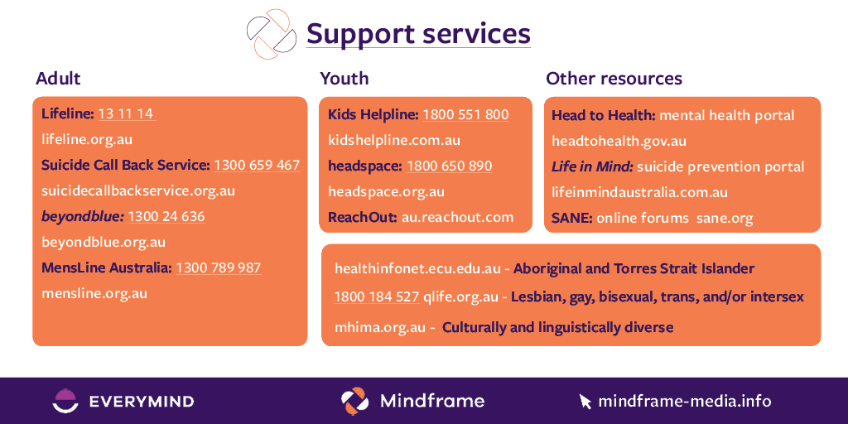
Tip 5: Encourage people to seek help

Slide 26
What next?
Be prepared:
Use of language / prepare key messages
Have help-seeking information ready to provide if required (for yourself and others)
Contact the Mindframe team if you need more support

Slide 27
Self-care
Talk to someone you trust or contact a service if in need of immediate support.

Slide 28
Thank you!
www.mindframe-media.info
Jennifer.Howard@hnehealth.nsw.gov.au
Rebecca.Pryor@hnehealth.nsw.gov.au
Mindframe@hnehealth.nsw.gov.au

