Slide 1
Parliamentary Inquiry into EfW technologies

Slide 2
New Energy Corporation
WA Company formed in 2009
Worldwide Licensee (ex-Americas) for the Australian developed Entech Waste to Gas technology with 46+ international projects over 20 years
Australian Projects with two (2) EPA Approvals:
Port Hedland
East Rockingham
Established as the leading company in the waste to energy market in Australia

Slide 3
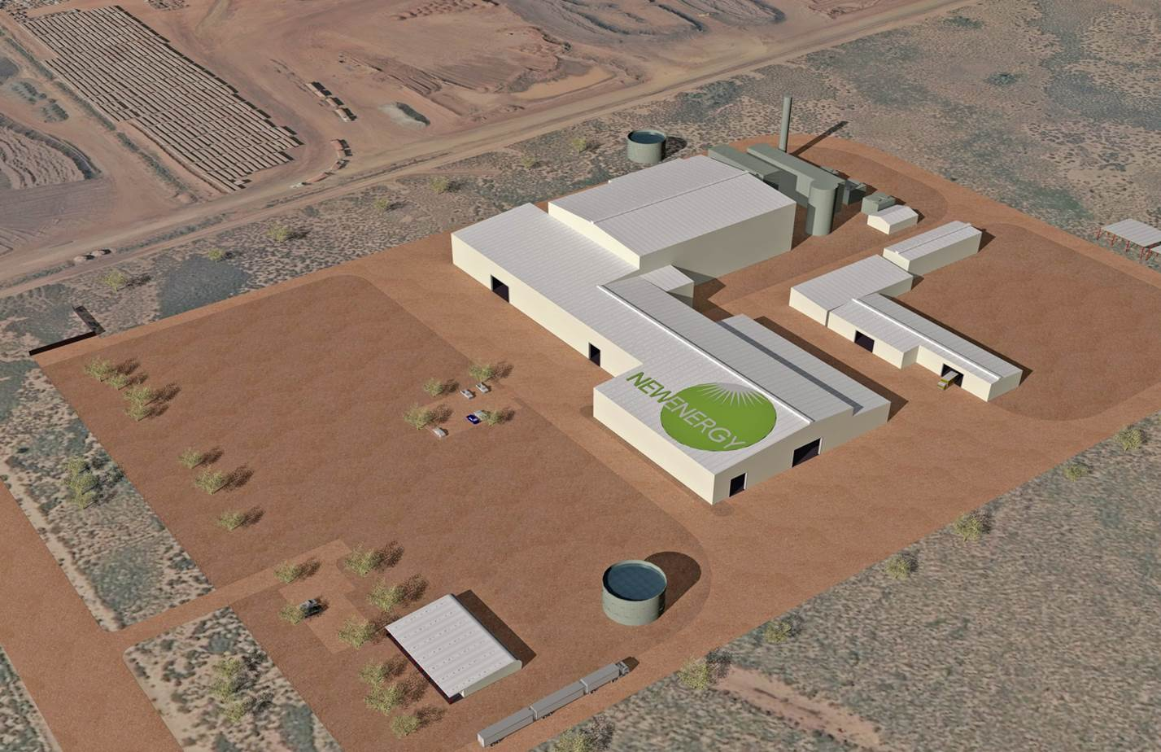
Port Hedland Waste to Energy Project

Slide 4
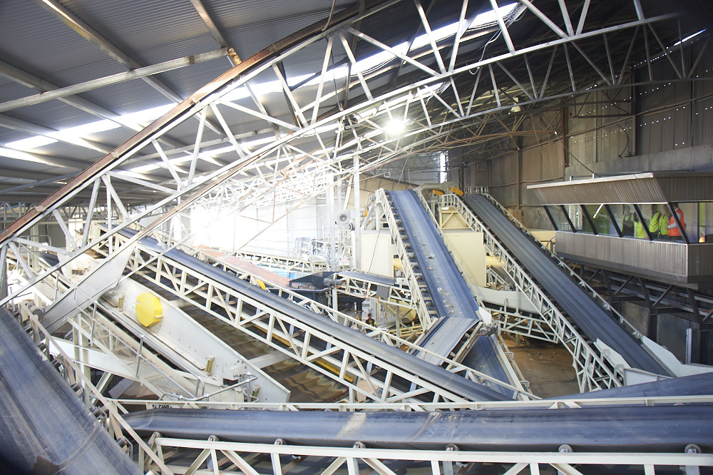
Materials Recovery Facility

Slide 5
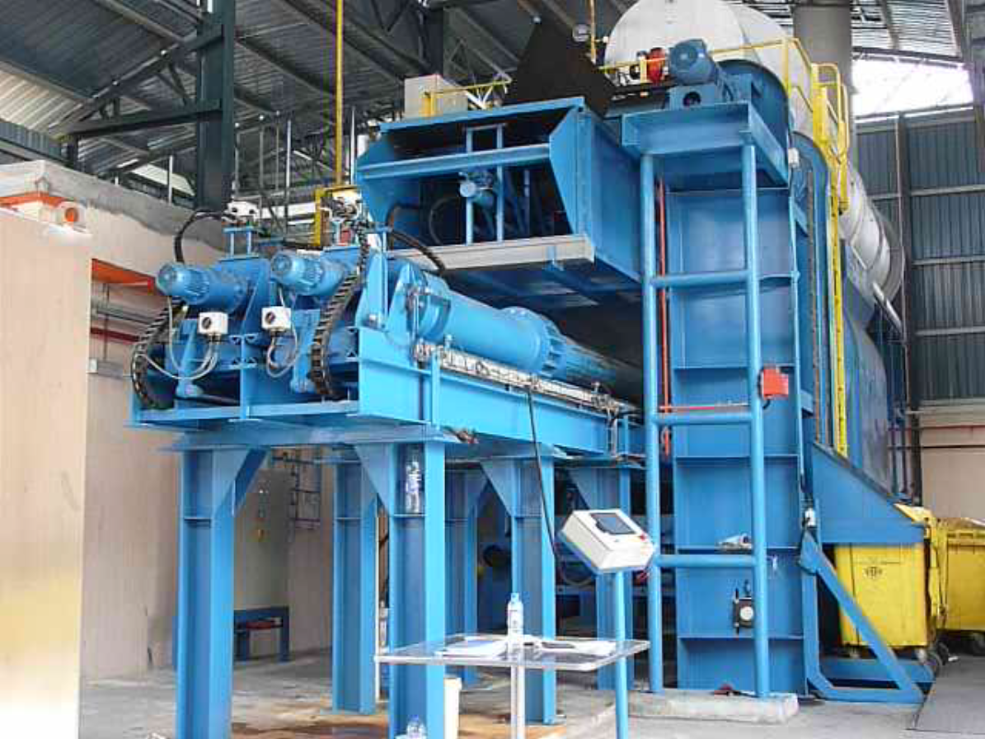
Gasification Stage

Slide 6
Project Features
$150 million – non mining investment
Capacity of 80,000 - 110,000 tonnes of waste pa
Materials Recovery Facility to maximise recycling opportunities
3 gasification trains, ability to scale up as demand increases in the future
Generating 6.5 MW of electricity for sale on NWIS
First renewable energy on the North West Interconnecting System.

Slide 7
EPA Approvals History
Site Selected in 2011
Level of Assessment: PER 2012
PER Released: August 2012
EPA Section 16 Advice
No Submissions Against
Ministerial Approval May 2013

Slide 8
WA EPA Section 16(e) advice
Conclusion 1
Waste to energy plants have the potential to offer an alternative to landfill for the disposal of non-recyclable wastes, with the additional benefit of the immediate capture of stored energy.
Conclusion 2
It has been demonstrated internationally that waste to energy plants can operate within strict emissions standards with acceptable environmental and health impacts to the community when the plant is well designed and operated using best practice technologies and processes.

Slide 9
Community - Key Learnings
Community is the #1 stakeholder in all EfW Projects
Making the issues “Local and Relatable”:
“EfW is done all over the World so you have nothing to worry about” is not going to convince your local community.
Effective Listening is a priority
Face up to the hard issues – if they are real to the community then they are real!
The EIA Document is not an effective communication tool for local communities!

Slide 10
Summary
The EPA has a key leadership role to address the question: - “Is best practice EfW safe for the community and environment?”
Every project and community is unique
Using residual waste as a resource just makes good sense
The amount of waste going to landfill per annum could provide the annual power needs for over 700,000 NSW households (26% of total households).

Slide 11
Thank you for your attention
Questions please contact:
NEW ENERGY CORPORATION PTY LTD
Suite 1, 12 Parliament Place, West Perth, WA 6005
PO Box 1036, West Perth, WA 6872
P: +61 8 9226 0722 F: +61 8 9481 8023
ABN: 16 139 310 053
www.newenergycorp.com.au

